Slide 1

By Frank Moore
BEST UNIVERSITIES IN THE UNITED KINGDOM

Slide 2
TABLE OF CONTENTS
Table of Contents
Introduction
Objectives
Data Visualisation
Observations
Recommendation

Slide 3
Introduction
Delving into the choices of international students regarding optimal university selection, this project unveils key factors in shaping academic and professional paths.
Campus location, Minimum IELTS scores, Fees, and Staff strength emerge as pivotal influences for students, guiding them toward their best-fit educational journey. The intricate interplay of these elements unveils a comprehensive understanding of university decisions.

Slide 4
Objectives
UNIVERSITY RANKINGS AND ACADEMIC STRENGTH
Identify the best-ranked university in the UK based on global rankings.
Determine universities with the lowest average Undergraduate and Post-graduate fees.
DEMOGRAPHICS AND LOCATION
Evaluate the world ranks of various universities in the UK.
Analyze the academic strength of these universities.
AFFORDABILITY AND FEES
Assess the cost-effectiveness of education at different institutions.
Examine the percentage of international students in top-ranked universities.
Explore student enrollment trends based on minimum IELTS scores.
Study student enrollment patterns in relation to campus location.
Estimate the cost of living associated with various campus locations.
STUDENT EXPERIENCE AND SATISFACTION
Investigate universities with the best student satisfaction rates.
Analyze factors contributing to a positive student experience.

Slide 5
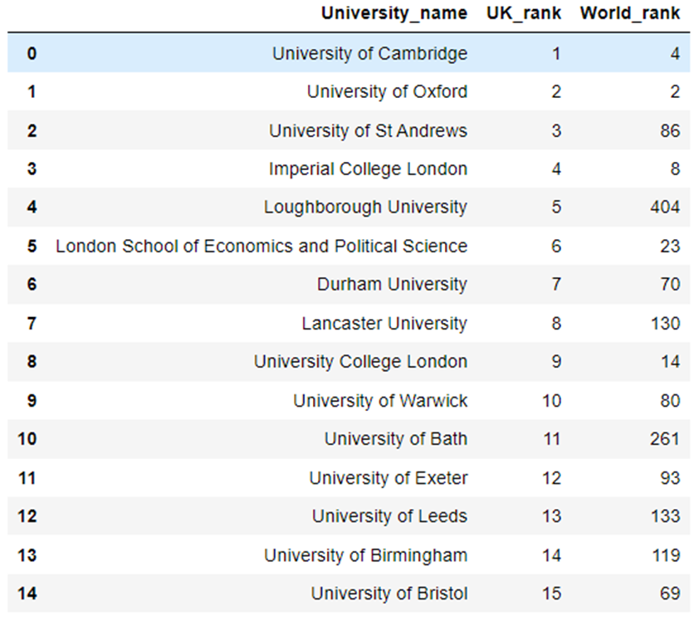
Rank of Universities in the UK
The table shows the ranking of universities in the UK, and their world ranking

Slide 6
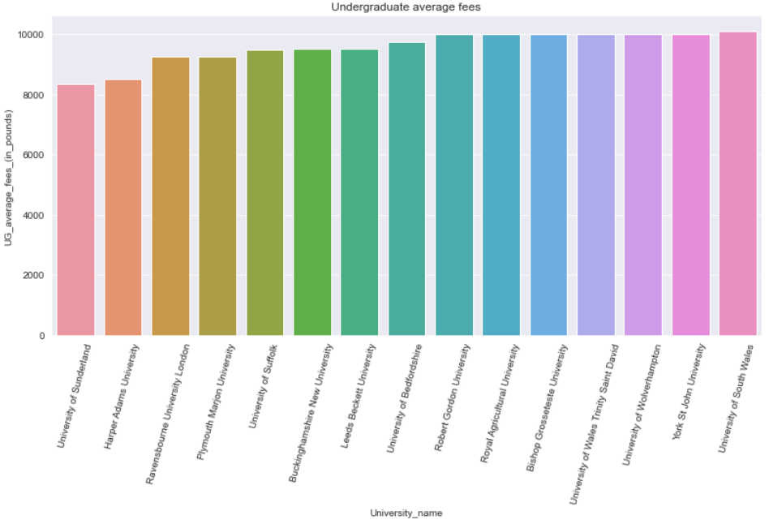
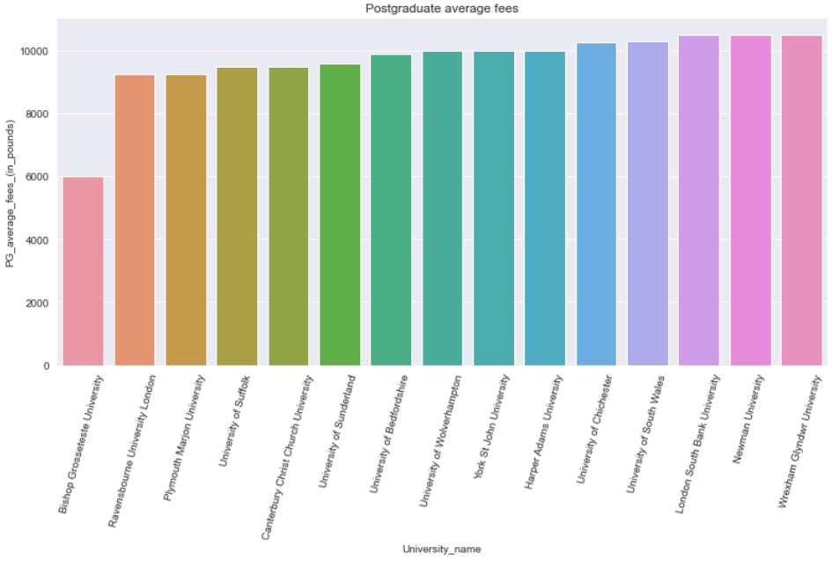
Average Fees of Universities
The data shows the average fees for Undergraduate and Postgraduate studies across 15 [paying between 2,000 – 10,000] universities in the UK

Slide 7
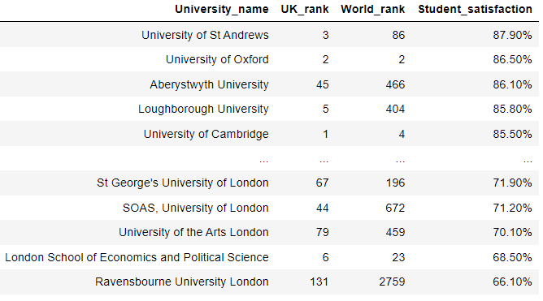
Student Satisfaction Survey Across UK Universities
From the data provided, the table shows the distribution of student satisfaction rate across UK Universities.
Aberystwyth University has a satisfactory rate of 86.10% despite being ranked 45th & 466th in the UK and world ranking respectively
There must therefore be some advantage that speaks to the international community in the university

Slide 8
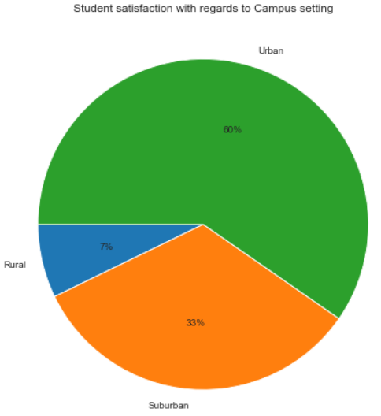
Student satisfaction by University Location
60% of students were satisfied with Universities located in the urban areas, showing a bias toward the urban environment [which may include the lifestyle and culture]

Slide 9
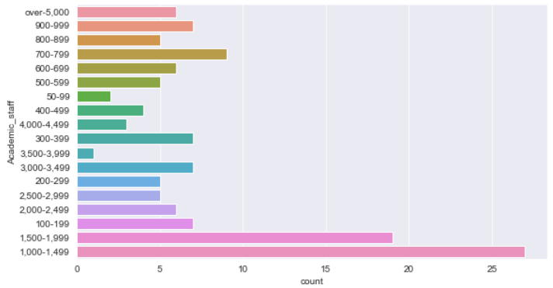
Academic Strength
The data shows the academic strength of universities across UK.
From the data, more than 25 Universities have an academic staff strength of between 1,000 – 1,500.

Slide 10
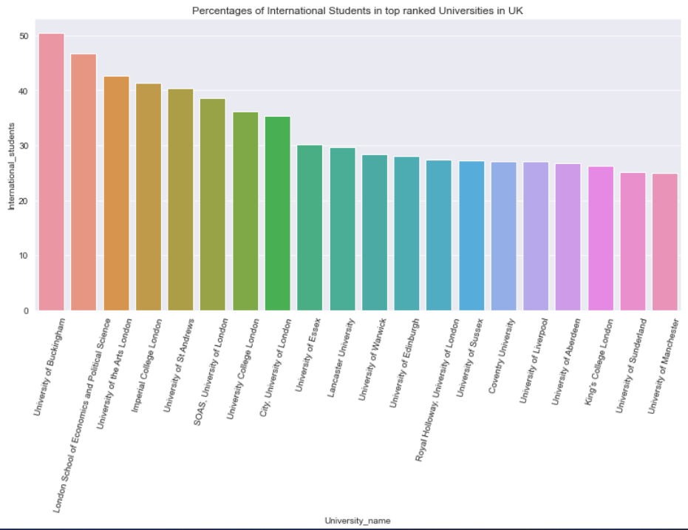
Percentage of International Students in UK Universities
The data shows the percentage distribution of 20 Universities in the UK with the highest number of international students.

Slide 11
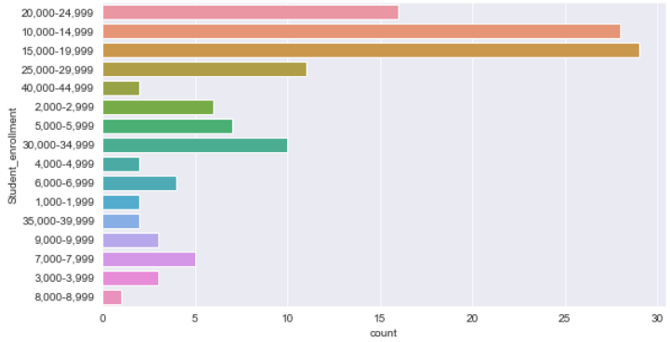
Student Enrolment Survey Across Universities in UK
The data shows the number of universities with the highest number of student enrolment.

Slide 12
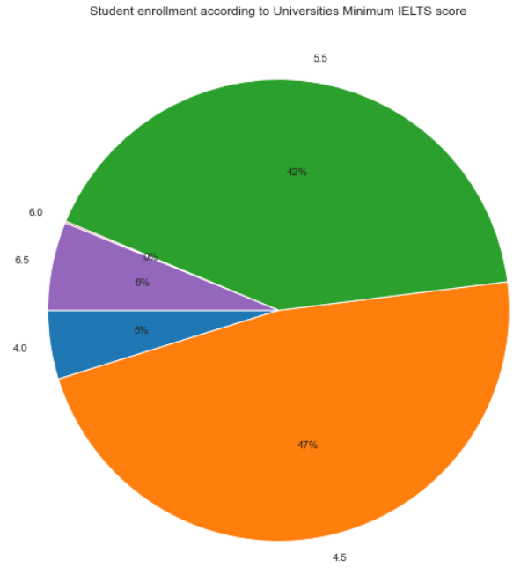
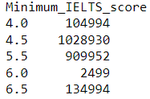
Student Enrolment By Universities’ Minimum IELTS score.
47% of students enrolled in Universities with a minimum IELTS score of 4.5.
42% enrolled in Universities with a minimum IELTS score of 5.5.

Slide 13
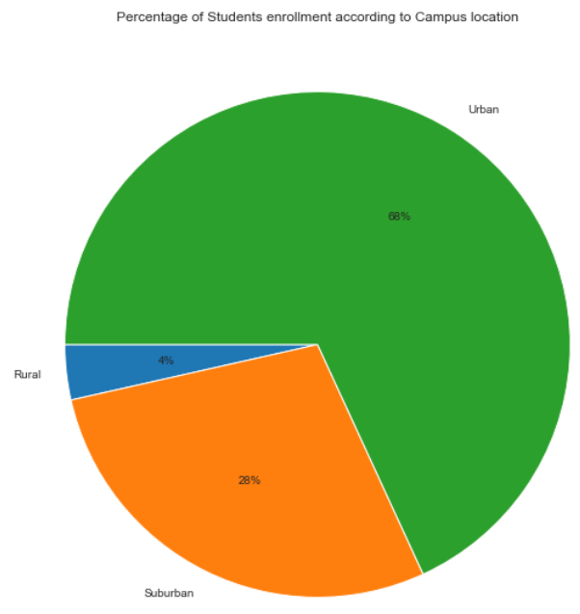

Student Enrolment By Campus Location
60% of students enrolled in Universities located in the urban areas, showing a huge preference to the urban areas compared to the suburban and rural areas collectively.

Slide 14
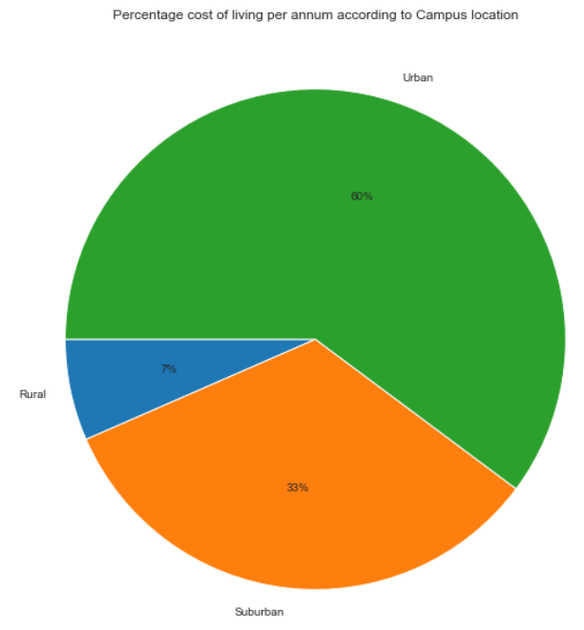

Estimated cost of living according to Campus Location
The data shows that there is an increase in the cost of living for students who live in the urban campuses as against other areas.

Slide 15
Observations
University Location Preferences
Majority of students prefer urban universities over rural ones
International Student Percentage
International students comprise 50% and less of the student body in UK universities.
Among the top 10 ranked universities, only 3 have slightly above 40% international students.
Minimum IELTS Scores
Minimum IELTS scores range from 4.0 to 6.5 for UK universities.
Over a million students enrolled in universities with a minimum IELTS score of 4.5.
About 909,000 students enrolled in universities with a minimum IELTS score of 5.5.

Slide 16
Observations
Enrollment and Location
Cost of Living
Universities located in urban areas have higher student enrolment, suggesting that the cost of living in urban areas is likely to be higher than suburban and rural areas.
Urban universities attract more than twice the number of students compared to suburban and rural universities combined.
Academic Staff and Rankings
The top 2 ranked universities have over 5,000 academic staff.
Universities with minimum IELTS scores of 4.5 and 5.5 tend to have fewer academic staff.

Slide 17
Recommendations:
Location Consideration
Intending students (undergraduates and post-graduates) are advised to prioritize schools located in urban areas due to their prevalence in the UK.
International Students Focus
International students aiming to study in the UK should target universities with a substantial percentage of international students, such as University of Buckingham (50%), London School of Economics and Political Science (47%), and University of Andrews (40%), as these universities tend to be more accommodating.
Cost of Living
Students with financial constraints should consider schools in suburban and rural areas due to lower cumulative living costs compared to urban areas.
Top Ranked Universities for buoyant students
Affluent students seeking education in the UK are recommended to apply to the top 3 ranked universities. Despite higher tuition fees, these universities offer strong student satisfaction, better IELTS scores, a reasonable proportion of international students, robust academic staff, and are situated in urban areas.

